Slide 1
Practice #4
Create Performance Task

Slide 2
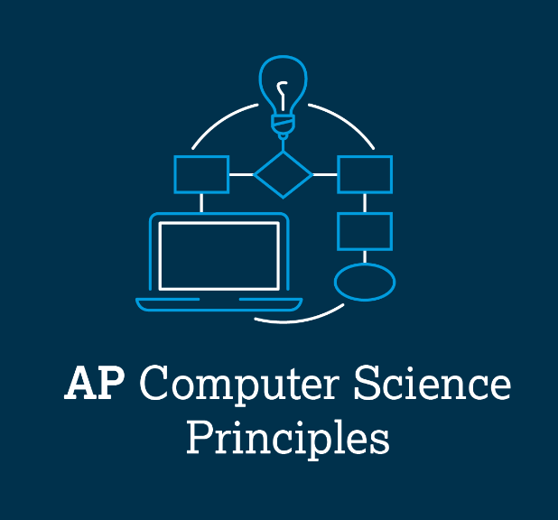
AP CSP Create Performance Task
Part of the AP Exam is to create a program that meets specific requirements:
Creates a list
Uses a list in a meaningful way
Has a function with a parameter
  Parameter affects function execution
Function has:
  If statement
  Loop

Slide 3
AP CSP Create Performance Task
The Create PT is like a remix project:
Start small and add components.
Start with what you know.
Don’t try something new that you don’t know how to do.
This isn’t a time to learn something new, but to show what you know how to do.

Slide 4
AP CSP Create Performance Task
The Create PT is like a remix project:
For this remix project, let’s create a project that is similar to PT_Practice2 and PT_Practice3.
Open each program and review what it does and how it does it.

Slide 5
AP CSP Create Performance Task
The Create PT is like a remix project:
PT_Practice2 uses a matrix and is a speed game.
PT_Practice3 uses two lists and picks a random student from one of the lists.
Let’s create a speed game with a single list that picks a random item from the list as part of the speed test.

Slide 6
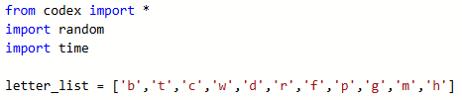
Practice #4
In CodeSpace, start a New File and name it PT_Practice4
Import the modules you will need for the program
Create a list of items to pick from. In this example, the list of items contains single letters. You can have as many items as you want.

Slide 7

Practice #4
Create a function similar to the pick_student() function.
Use a parameter for the speed of the game.
Use an if statement with the parameter to initialize delay.

Slide 8
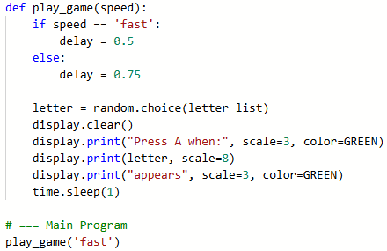

Practice #4
Like the code in PT_Practice2, select a random item from the list.
You have only one list, so the code is more simple.
Include a message that for the game, you press a button when the item appears.
Call the function for testing.

Slide 9
Practice #4
Run your code and make any changes you want:
  Size
  Color
  Words
  Button to press
  etc.

Slide 10


Practice #4
Check the PT Requirements:
Creates a list
Uses a list in a meaningful way
Has a function with a parameter
  Parameter affects function execution
Function has:
  If statement
  Loop

Slide 11
Practice #4
You need to add a loop!
Review the code in PT_Practice2.
It uses a loop to randomly select an item to display, and also checks the button press.
This function will do something similar.

Slide 12
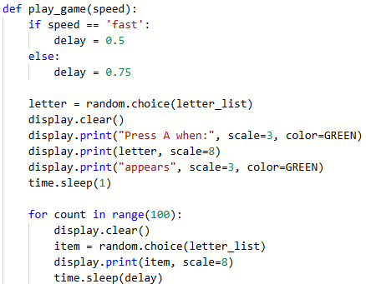
Practice #4
First, add a loop to select a random item and display it on the screen.
What is the range for the loop?
In PT_Practice2, the range was set by the level.
For this game, you will display random items until the player presses a button.
So the range needs to be a fairly large number to ensure the item is randomly selected at least once.

Slide 13
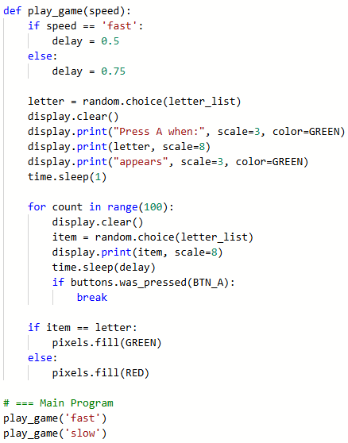
Practice #4
Refer to PT_Practice2 again.
Look at the button press.
You will include similar code.
When the player presses a button, you need to break the loop and see if the current item is the selected item.
Run the code several times.
Try both is_pressed and was_pressed.
Choose the one you like best.

Slide 14
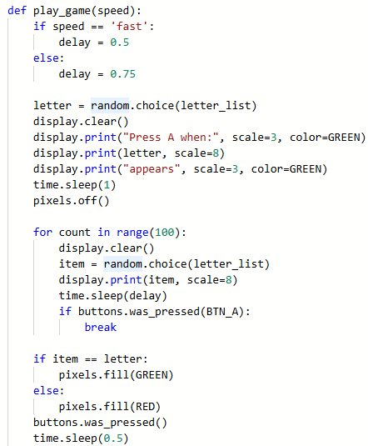
Practice #4
You probably noticed a few things:
The pixels stay lit, so it is hard to tell when the new challenge starts.
You need to “debounce” the buttons.
Add more code to fix the problems.

Slide 15
Practice #4
Revisit the PT Requirements:
Creates a list
Uses a list in a meaningful way
Has a function with a parameter
  Parameter affects function execution
Function has:
  If statement
  Loop

Slide 16
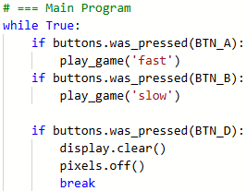
Practice #4
Now you just need to complete the main program.
Run the code and make any changes you want.

Slide 17
Practice #4
Last step: Code a function that gives instructions.
This program will really benefit from having an intro or instructions so the user knows what buttons to press.
You can code the intro function any way you want.
You are on your own to do this. If needed, use PT_Practice3 as a guide.
Think about when you want the instructions to be displayed.

Slide 18
Practice #4
Something to consider:
The play_game() function meets all the requirements for the Create PT.
However, it is pretty long. That is okay. You can submit a long function.
But you can also create a couple functions from play_game() that aren’t necessary for the requirements.
Then play_game() can call the functions and make it easier to read and follow.

Slide 19
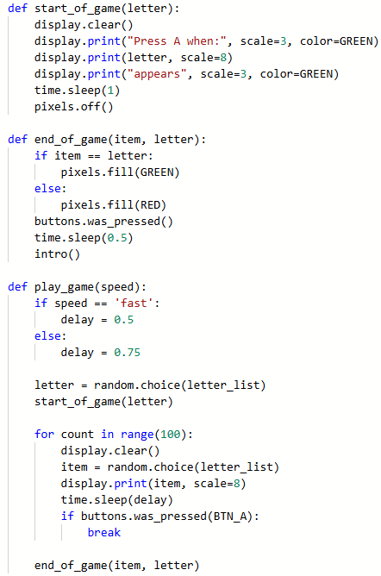
Practice #4
Here is an example:
Create a function for the code near the beginning that displays the random letter.
Create a function for displaying the results.

Slide 20
Practice #4
Revisit the PT Requirements for play_game():
Creates a list
Uses a list in a meaningful way
Has a function with a parameter
  Parameter affects function execution
Function has:
  If statement
  Loop

Slide 21
Practice #4
Even by creating two small functions, play_game() still meets the requirements!
And, it is easier to read and explain.

Slide 22
Practice #4
Now that you have seen an example a remix from two PT Practice programs, can you think of any other ways to remix any of the PT Practice programs for the Create PT?
Go to the Activity Guide and write down any more ideas you have for modifications.

Slide 23
Practice #4
Final considerations.
Your program needs to have input and output.
  Be prepared to explain the input and output of this program.
  This program has input through button presses.
  In a video, you want to show the button presses, or add a caption that explains how the video shows input
  The output is the text on the screen and the pixels.
  In a video, you want to show clear text on the screen, and the pixels in color.

Slide 24
Practice #4
Final considerations.
Your program needs to have a specific purpose and intended user.
  The purpose of this program could be explained as entertainment, or as a way to test hand-eye coordination.
  The function is to play a game that shows a random item from the list and requires the player to press a button when it appears.
  The intended user is a middle or high school student for entertainment. A possible intended user for hand-eye coordination could be a senior citizen who wants to stay sharp.

